Slide 1

Neil Yetz
…

Slide 2
What is Campus Connections?
Service-learning course (HDFS 470)
Open to all majors/years at CSU
Offered every fall and spring
Four sections (Mon, Tues, Wed, Thurs from 3-9 pm)
Students mentor at-risk youth (11-18 yrs) referred from the juvenile justice system, schools, human services, etc.
Mentors are paired 1:1 with youth and work both individually and in multidisciplinary teams

Slide 3
Background
2009:
Rates of youth involved in the juvenile justice system increased dramatically during the economic recession
District Attorney & Juvenile Magistrate asked for creative solutions
Research based design – best practices in mentoring
Federal funding to launch program ($500,000 - CNCS grant)
2010:
Launched two sections – Spring 2010
Mentors from only four majors (HDFS, HES, Psych, Spanish)
Expanded to include students from all major and all years at CSU due to student demand

Slide 4
Current Achievements
2010-2015:
Four sections every fall/spring + two summers
Approximately 32 mentoring pairs per section
Over 2,000 CSU students have participated
Over 1,700 at-risk youth have participated
CSU students from over 90 different majors
CC launched at UNC this semester
William T. Grant Foundation 3 year funding ($580,000)
Other grants and contracts include:
Bohemian Foundation United Way El Pomar Justice Assistance Grant | Poudre School District Thompson School District Department of Human Services Senate Bill 94
Notes:
The coefficients and odds ratios for all of the model’s covariates are provided in Appendix B. Odds ratios can be difficult to interpret in a practical sense; therefore, figures 1 and 2 graph the model’s predicted probability of graduating for a CC new freshman and transfer student compared to a non-CC peer assuming all other things are equal over six years of enrollment.

Slide 5
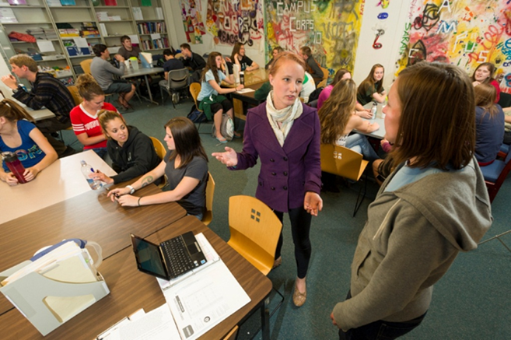
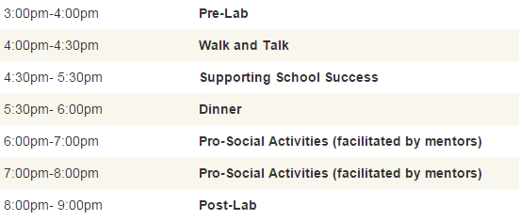
Schedule
Weeks 1-3: Mentor Training
Weeks 4-15: Mentoring & Training

Slide 6
Institutional Research Outcomes
CSU student participation in CC is associated with 63% lower odds of dropping out of CSU in any given year (2012)
CSU student participation in CC is associated with 127% higher odds of graduating (2015)
Both of these are after controlling for a number of factors that have been shown to predict persistence and graduation.

Slide 7
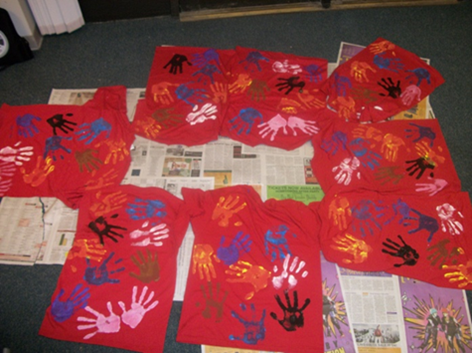
Program Evaluation Findings
Participation in Campus Corps accounted for significant changes:
Community Service Self-Efficacy
Service Learning Benefit
Self-Esteem
Civic Attitudes
Political Awareness
Civic Action
Interpersonal Social Skills

Slide 8
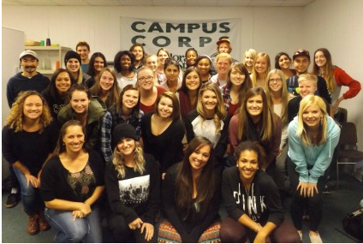
Student experiences
“I was ready to drop out of college before joining Campus Corps and now, because of my time spent with the youth, I am excited about the possibility of pursuing an education degree.”
“I graduated over a year ago and Campus Corps was the most meaningful and rewarding part of my college career.”
“[In Campus Corps] I gained a whole family and a place to belong at CSU.”

Slide 9
For more information, please contact:
Jen Krafchick, PhD, CFLE
Assistant Professor
Human Development and Family Studies
jen.krafchick@colostate.edu
970-491-2171
Visit us online:
http://www.hdfs.chhs.colostate.edu/students/undergraduate/campuscorps/

